Slide 1
Course Name: Database Management System
Course Code: CS116
Dr. Praveen Kantha

Slide 2
JOIN

Slide 3
WHAT IS SQL JOIN
SQL join combines rows from more than one table by using common column in both the tables.

Slide 4
WHY WE USE SQL JOIN?
Flexibility - It allows the user to access and manage records from more than one table.
Data Redundancy - SQL join allows us to keep data redundancy low so that we can reduce the amount of data anomalies.
Efficiency - Executes faster and shows results much more quickly than any other sub query.

Slide 5
TYPES OF JOINS
INNER JOIN
OUTER JOIN
LEFT JOIN
RIGHT JOIN
CROSS JOIN
SELF JOIN
NATURAL JOIN

Slide 6
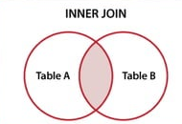
INNER JOIN
Inner join returns a new table by combining records that only have matching values in both tables.
SYNTAX
SELECT table1.col_name, table2.col_name,...... FROM table1
INNER JOIN table2 ON table1.column = table2.column;

Slide 7
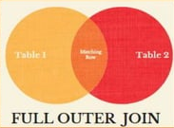
OUTER JOIN
Outer join returns all those records which are in either the left table or right table.
SYNTAX
SELECT table1.col_name, table2.col_name,...... FROM table1
FULL OUTER JOIN table2
ON table1.column = table2.column;

Slide 8
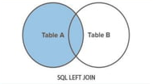
LEFT JOIN
Left join returns all the rows from the left table and matching rows from the right table.
SYNTAX
SELECT table1.col_name, table2.col_name,...... FROM table1
LEFT JOIN table2
ON table1.column = table2.column;

Slide 9
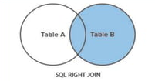
RIGHT JOIN
Right join returns all the rows from the right table and all the matching records from the left table.
SYNTAX
SELECT table1.col_name, table2.col_name,...... FROM table1
RIGHT JOIN table2
ON table1.column = table2.column;

Slide 10
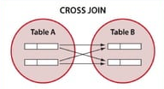
CROSS JOIN
A Cross Join is a type of join that returns the Cartesian product of rows from the tables in the join. In other words, it combines each row from the first table with each row from the second table.
SYNTAX
SELECT table1.col_name, table2.col_name,...... FROM table1
CROSS JOIN table2
ON table1.column = table2.column;

Slide 11
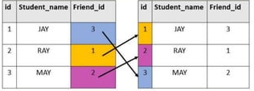
SELF JOIN
A self join is a join in which a table is joined with itself (which is also called unary relationship).
To join a table itself means that each row of the table is combined with itself and with every other row of the table.
SYNTAX
SELECT column(s)
FROM tablel t1, tablel t2 WHERE condition;

Slide 12
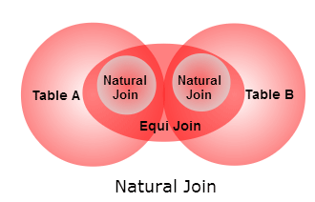
NATURAL JOIN
Natural join is an SQL join operation that creates a join on the base of the common columns in the tables. To perform natural join there must be one common attribute(Column) between two tables. Natural join will retrieve from multiple relations.
SYNTAX
SELECT *
FROM TABLE1
NATURAL JOIN TABLE2;

